Slide 1
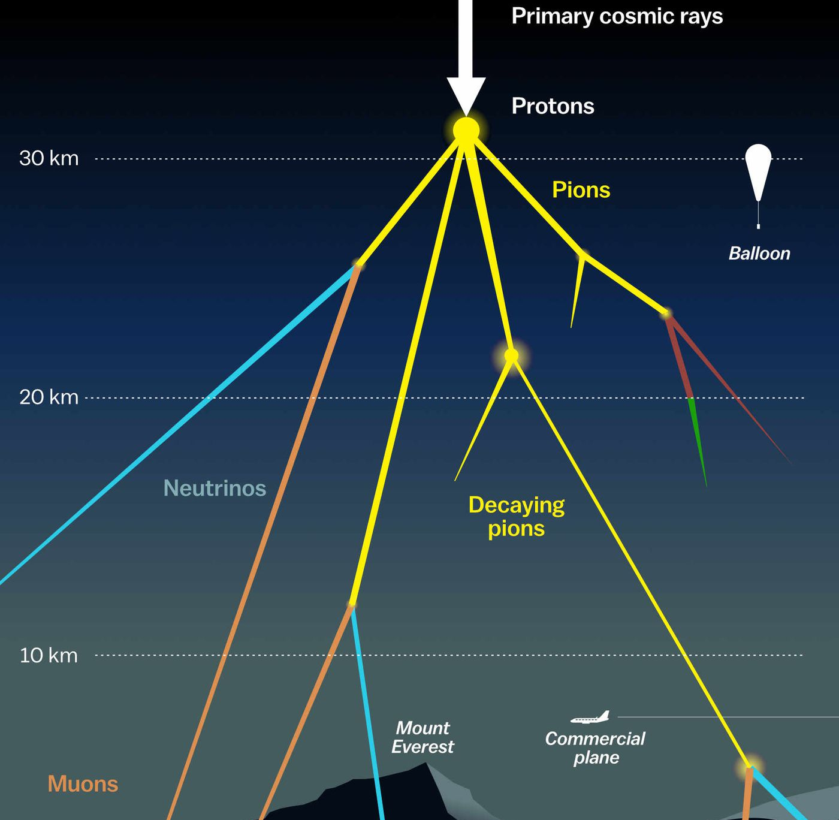

Measuring the prompt component of the atmospheric muon flux Pascal Gutjahr
August 30, 2024
Source: NASA

Slide 2
Generated systematics (level5)

Slide 3
Absorption

Slide 4
DOM efficiency

Slide 5
Scattering

Slide 6
HoleIce model p0

Slide 7
HoleIce model p1

Slide 8
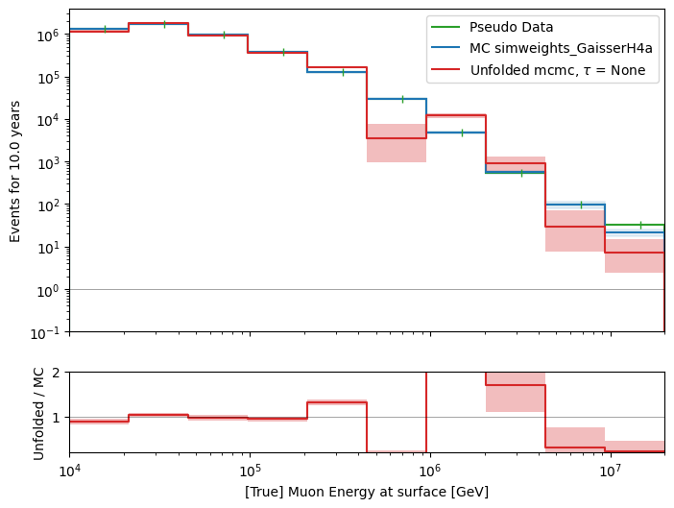
Unfolded event rate – fitted with detector systematics

Slide 9
Systematics correlation

Slide 10
Bin to bin correlation

